Slide 1




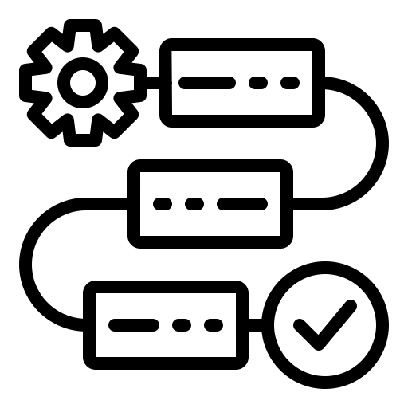
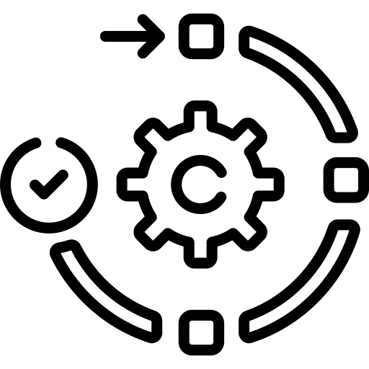


Traditional Gen AI Assurance VS Multi Agentic Gen AI Assurance
Coverage
Multi Agentic Gen AI Assurance Workflow
Coverage
Traditional Gen AI Assurance Workflow
Relevancy
Relevancy
Coherence
AGENTIC F/W AGENT
Coherence
Contradiction
SME Verified Test data
(Question & Answer)
Contradiction
SME Verified Test data
(Question & Answer)
ADVISOR
Conciseness
Conciseness
Score
AUT
Score
PROMPT TUNER
QC Relevance
QC Relevance
Reason
Context Utilization
Reason
CRITIQUE
Context Utilization
Question
COVERAGE CHECKER
Additional insights on Score & Reason
Hallucination
CONTEXT GATHERING
Hallucination
AUT
Toxicity
RESULT CORRECTOR
Toxicity
PII detector
FEEDBACK COLLECTOR
PII detector
Criminality
Criminality
Stereotype
Agents extend the capability of LLM by leveraging information gathered , suggest actions & plan and execute complex tasks
Stereotype
GOAL, TARGET & INSTRUCTION
REASONING & FEEDBACK
WORKFLOW GENERATION
EXECUTION
OUTCOME
AGENTIC WORKFLOW SIMPLIFIED VIEW
1
2
3
4
5

Slide 2
Advantages of Traditional Gen AI VS Agentic Gen AI
Static Evaluation Prompts
Dynamic feedback-based Prompts
Static workflow
Optimised effective workflow
No Scoring feedback
Feedback based scoring correction
Token consumption not optimised
Optimised token consumption
No Insight collection
Feature store from failures & human feedback
Traditional Gen AI Assurance
Multi Agentic Gen AI Assurance

Slide 3

Double click view on an Multi Agentic flow
cv
RESPONSE A
"Acknowledge customer feedback, investigate issues, and take corrective actions."
"Respond to feedback, identify problem areas, and implement necessary changes."
"Address feedback promptly, root out issues, and keep customers informed about improvements."
"Immediately analyze feedback, prioritize corrective actions, and communicate changes."
Advisory Agent
SME VERIFIED QUESTION
GOAL
TARGET
ACTION
Derive the drift between the Groundtruth & Actual response
Based on the Drift derived suggest the sequence of Metrics to be considered & the workflow to be followed
Provide feedback and advice to be followed by the Prompt tuning Agent
How should we handle the negative customer feedback received post-launch for our latest product?“
SME VERIFIED RESPONSE
To handle negative customer feedback, first acknowledge the feedback, analyze the root causes, implement corrective actions, and communicate improvements to customers
RESPONSE B
"Negative feedback doesn't always require corrective actions."
"Consider the volume of feedback before making changes."
"Acknowledge customer feedback, but corrective actions aren’t always necessary."
Observation
Thought
Plan
Action
Response A
I should suggest that on the Model quality metrices, the hallucination consistency check would be sufficient & CoVe/Knowhalu can be skipped as the drift in responses of actual and expected seems to be low. Workflow should be defined to keep certain items in memory and check the scores
Workflow Plan :These metrics are to be considered & executed in same
sequence
Factuality → Facts contradicting
QC Check → Context missing
Contradiction → Facts contradicting
Hallucination → Hallucination Consistency metric only
Context Utilization → Context not utilised
Initiate the next flow of Action starting from Factuality.
As a guideline the following should have a high metric score :
Factuality, QC check, Context Utilization
Following should have a low metric score :
Contradiction, Hallucination
Additional insights gathered rom the global memory to be utilised for prompt tuning of respective metrics.
OK!! Response A seems to be stable very similar to Groundtruth data. The factual points are correct, I only see a difference in the way the response is structured. Actual response seems to be more detailed
Global Memory
Gaps Saved
Supporting evidences for metric
PUSH
Observation
Thought
Plan
Action
Response B
Initiate the next flow of Action starting from Factuality.
As a guideline low metric score for Factuality, QC check, Context Utilization & high metric score for Contradiction, Hallucination
Following insights to be utilised for prompt tuning of respective metrics like Factuality, Hallucination :
Ensure the system plans actions without dismissing feedback based on volume. Validate the presence of actionable elements.
Focus on how the response improves customer experience.
Check if there is a structured follow-up plan. Ensure no harmful assumptions about feedback volume are included.
OK!! Response B seems way too drifted from the Groundtruth
The factual points are contradicting especially on the line's which states :
Feedback doesn't require corrective actions
Feedback volume matters to take an action
Corrective actions are not required
I should suggest that on the Model quality metrices, all the hallucination checks such as consistency, CoVe/ Knowhalu to be considered. Workflow should be defined to almost all metrics which focusses on the quality of output
Workflow Plan :These metrics are to be considered & executed in same
sequence
Factuality → Facts contradicting
Hallucination → All Metrics of Hallucination
Context Utilization → Context not utilised
QC Check → Context missing
Contradiction → Facts contradicting
PUSH
Global Memory
Gaps Saved
Utilised as supporting evidences by any metric

Slide 4

Multi Agentic Workflow for Generative AI Assurance
Scenario: Q&A for Product Issue Resolution During a New Product Launch
3
5.1
1
Metrics Eval F/W
2
Response Set #1
4
Brief on Steps
Question:
"How should we handle the negative customer feedback received post-launch for our latest product?“
Generated Response: "To handle negative customer feedback, first acknowledge the feedback, analyze the root causes, implement corrective actions, and communicate improvements to customers."
"Acknowledge customer feedback, investigate issues, and take corrective actions."
"Respond to feedback, identify problem areas, and implement necessary changes."
"Address feedback promptly, root out issues, and keep customers informed about improvements."
"Immediately analyze feedback, prioritize corrective actions, and communicate changes."
Hallucination Consistency
Advisor Agent
Hallucination CoVe
GOAL : Review the responses from Metric evaluation & provide the next actions. TARGET : If there is any discrepancy, gaps observed advise the next corresponding agent to incorporate your advice carry forward the steps
INSTRUCTION : If hallucination is consistent and you detect no drift then no more hallucination family metrics are to be evaluated else advice the CoVe & Knowhalu agents
STEP #1 : The generates response from the application under test or the question is passed for validation against Metrics
STEP #2 : Curated 40+ Metrics for validation of the quality of response
STEP#3: Hallucination metric is considered for this workflow here, for hallucination consistency , multiple responses are generated for the same question to see if there is any drift.
Gen AI solution: Validates, calculates the drift and provides a score and reason.
Proposed Gen AI solution : Does not stop there, a multi agent system gets deployed to with a specific goal/target to cross verify each of the output and based on the goal set it initiates the next agent or the next function call.
STEP #4 & #5: The responses with the metric score derived is considered and validated by the Advisor Agent and then if it detects a conformed no drift it calls the next metric validation ELSE it invokes the Cove & Knowhalu agent with the specific corrective action.
STEP #5.1: Advisor agent interacts with Context extractor agent which extracts additional information from AUT on the observation lines
STEP #6 & #6.1: Dynamic prompt tuning agent will fine tune the prompt of Cove & Knowhalu to generate the further questions dynamically aligned with the main question to cross check the facts provided in the response are correctIy can also interact with context extractor agent which can collect additional contexts to adjust the prompt based on the advisor agent.
Step #7, #8 : The Cove & Knowhalu questions are generated
Step #9: Critique agent verifies if the questions are aligned to initial ask & rejects certain questions
Step #10: The Metric scores are derived for all the validations
Step #11 : Result Corrector Agent will analyse the results, look for contradictions like if factuality is high, hallucination can't be high & vice versa and re-initiates the metric that’s not logical to pull the accurate result
Step #12: Based on the failure's additional insights on weak areas of the AUT & suggestions to improve the test coverage with sample tests will be provided.
Hallucination KnowHalu
Response Set #2
"Negative feedback doesn't always require corrective actions."
"Consider the volume of feedback before making changes."
"Acknowledge customer feedback, but corrective actions aren’t always necessary."
Factuality
Relevancy
5
5
Hallucination 0.9
Factuality 1
7
<<No Drift detected>>
Proceed to Factuality
CoVe 0.5
Relevancy 0.3
Context Adherence
6.1
<<<<<<<Drift detected>>>>> Advisor Prompt Update for CoVe & KnowHalu:
Generate follow-up questions focusing on specific corrective actions
Ensure the system plans actions without dismissing feedback based on volume.
Validate the presence of actionable elements.
Focus on how the response improves customer experience.
Check if there is a structured follow-up plan. Ensure no harmful assumptions about feedback volume are included.
Misogyny 0
Coherence 1
Metric scores & Reasons are derived
& More
Dynamic Prompt Tuning Agent
GOAL : "Refine the prompt based on Advisor's feedback to ensure alignment with the primary question and adjust for context on corrective actions and customer impact if drift is detected." TARGET : Pick up the corresponding prompt and fine tune the prompt to incorporate the advice in such a way that its aligned with the primary question
INSTRUCTION : If you need any further information/ context on those lines extract the details from “Context extractor Agent” before tuning the prompt
8
6
FEEDBACK
Generate follow-up questions also includes the understanding of corrective actions as mandatory for addressing customer complaints. Ensure that questions validate alignment with the context and also aligns with the primary question
10
CoVe & Knowhalu follow up questions
9
"What specific corrective actions are needed after receiving negative feedback?"
Are corrective actions planned, irrespective of the feedback volume?
What steps are included in analyzing the root causes of negative feedback?
"Can corrective actions be avoided if the feedback is low in volume?“
"Should we prioritize enhancing product features instead of addressing negative customer feedback?"
Critique Agent
12
GOAL : Review the questions generated & flag the questions as “REJECTED” if its not aligned with advisor agent or the primary questions TARGET : "Reject questions that fail to address corrective actions, customer satisfaction metrics, or compliance requirements in alignment with Advisor's guidance."
REJECTED
Critique Agent Feedback: "Rejecting this question as it implies feedback can be ignored, contradicting the primary response's emphasis on addressing all feedback."
Context Extractor Agent
11
GOAL : To interact with the application interface to gather additional insights on what Advisor/Critique Agent is asking TARGET : To generate Q&As on the ask
Dynamic Result Corrector Agent
Additional Context Needed from Advisor or Critique:
To ensure the questions align with a proactive corrective action approach, the Context Extractor gathers specific insights from the advisor’s doubts regarding customer engagement and corrective action metrics.
Context Queries & Responses:
"What are the standard corrective actions for customer complaints?"
Response: "Actions include product enhancements, customer compensation, and operational changes."
"How does the company measure the effectiveness of corrective actions on customer satisfaction?"
Response: "Follow-up surveys and NPS scores are used to gauge improvement."
"Are there regulatory requirements tied to customer feedback resolution?"
Response: "Yes, certain complaints may require documented resolution under compliance guidelines."
GOAL : Review the metric scores as it gets populated and check if there are any logical conflicts in the metric scores TARGET : Flag the incorrect metrics by cross comparison of other reasons and advise the execution code to rerun and provide the score
INSTRUCTION : "If metric scores (e.g., Hallucination Consistency vs. Relevancy) conflict, analyze which score better aligns with the response context and advise for a targeted re-evaluation."
Insight Agent – Final recommendation & Analysis
GOAL : Capture and analyse the failures against each of the weak topics TARGET : Pick up the failure reasons and correlate the data of failures and suggest the dev team on what should be the corrective actions on the weak points
4
Key Identified Weaknesses:
Weakness in Coverage on Corrective Actions: Follow-up actions in response to customer feedback are adequately covered but lack detail on the impact on customer loyalty.
Recommendation: Expand training data on customer loyalty metrics and post-corrective action engagement.
Improvement on Customer Feedback Handling Data: Context around customer loyalty tracking post-feedback could be strengthened for better predictive modeling of customer retention outcomes.
Recommendation: Enhance data to capture metrics like follow-up engagement rates and satisfaction post-correction.
Observation : Factuality score is not getting aligned with Relevancy and Hallucination score. Re-initiate factuality function to rerun and get the updated score.
Analysis on all failure traces by the Agent

Slide 5
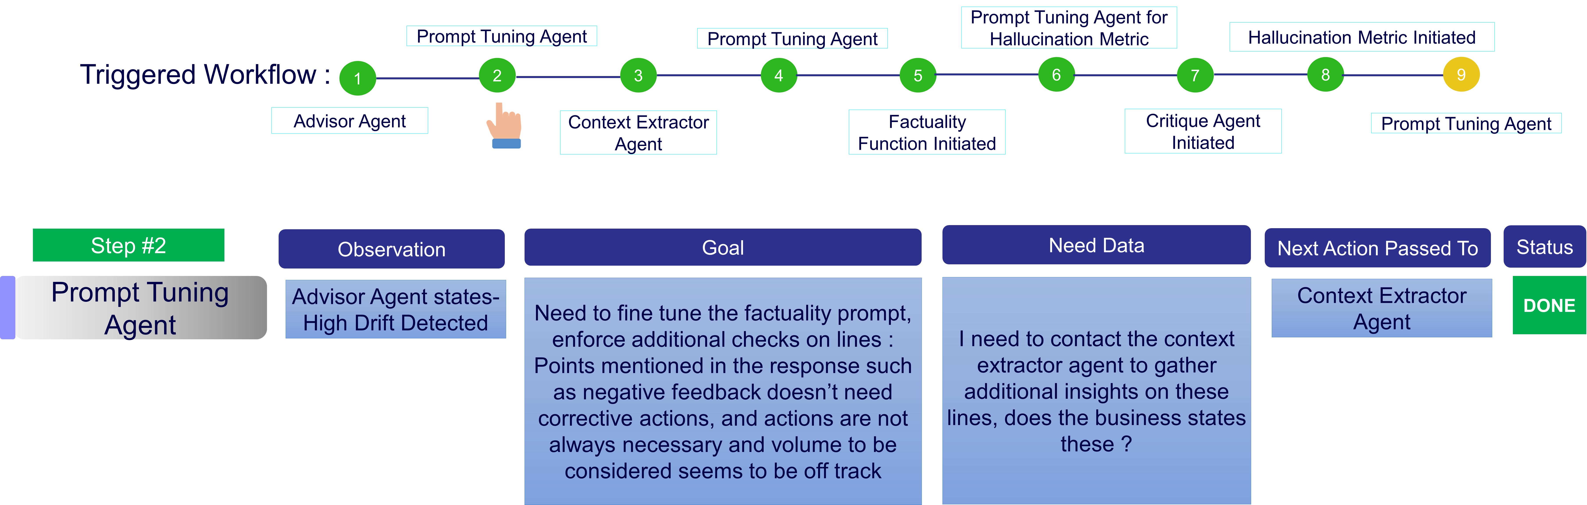

Evaluated Output of a Traditional Gen AI Assurance VS Multi Agentic Gen AI Assurance
SME VERIFIED QUESTION
SME VERIFIED RESPONSE
RESPONSE B
"Negative feedback doesn't always require corrective actions."
"Consider the volume of feedback before making changes."
"Acknowledge customer feedback, but corrective actions aren’t always necessary."
To handle negative customer feedback, first acknowledge the feedback, analyze the root causes, implement corrective actions, and communicate improvements to customers
How should we handle the negative customer feedback received post-launch for our latest product?“
Traditional Gen AI Assurance
Agentic Gen AI Assurance
OUTPUT
Human Verifier
OUTPUT
Agentic Framework
Evaluation Engine
Evaluation Engine
Hallucination Score
Agreed that hallucination is present in the response that got generated but why the is the score 0.6 ?
Should I re-run this data to see if the score and reason is consistent
Shall I provide some additional insights ?
Hallucination Score
0.6
1
Hallucination Reason
Points mentioned in the response such as negative feedback doesn’t need corrective actions, and actions are not always necessary and volume to be considered seems to be off track making the hallucination score to be 0.6
I see the additional questions and answers got generated
The insights gathered proves the reason for hallucination being high

Slide 6

Zoomed in View of the Workflow Insights
Prompt Tuning Agent for Hallucination Metric
Prompt Tuning Agent
Prompt Tuning Agent
Hallucination Metric Initiated
Triggered Workflow :
1
2
3
4
5
6
7
8
9
Advisor Agent
Context Extractor Agent
Factuality Function Initiated
Critique Agent Initiated
Prompt Tuning Agent
Step #2
Observation
Goal
Need Data
Next Action Passed To
Status
Prompt Tuning Agent
Advisor Agent states- High Drift Detected
Need to fine tune the factuality prompt, enforce additional checks on lines :
Points mentioned in the response such as negative feedback doesn’t need corrective actions, and actions are not always necessary and volume to be considered seems to be off track
I need to contact the context extractor agent to gather additional insights on these lines, does the business states these ?
Context Extractor Agent
DONE

Slide 7
Appendix

Slide 8



Assurance with LLM as evaluator & Multi Agent Architecture
LLM & Agents work in parallel
Test data Coverage Checker : Checks the topics against the auto generated test data & keeps stacking data/chunks related to topics dynamically where the test data is poor. It then auto creates additional test cases to meet the test data coverage target
Critique Agent: Checks the quality of questions that gets generated, if it gets aligned with the goal & guidelines of use case specific testing.
Reasoning & Pipeline trigger Agent: Runs the primary set of Metrics like Relevance, Hallucination & Factuality. Cross checks if the scores arrived are making sense e.g. If Hallucination gives a high score, then Factuality should not provide a high score & if it happens, the reasoning Agent will try to interpret and understand what went wrong and decides to invoke specific additional metrics calls like CoT, CoVe for additional verification until its goal gets satisfied.
Data Analysis Agent: Keeps stacking the failures against every Metric and performs a collative Analysis to classify and suggest the weak areas of the AUT.e.g. Hallucination is seen to happen when it's receiving any out of topic questions.
This Agent will be fed with all the guidelines, what's in scope, out of scope & also will have access to APIs to communicate with applications Vector DB to gather additional details if needed
Application Under Test
Another LLM leveraged as Judge
Multi Agent System collaborating on metrics derived and actions
Application is tested with the test cases generated and the responses are collected for evaluation.
Apart from rule-based checks which are performed without LLMs, another LLM is being leveraged to verify the response & provide scores on various metrices defined
Multiple Agents are deployed to cross evaluate each output and take corrective sub actions.
Self-correction Agent: Keeps a track of mistakes it commits for every run and suggests the tester on weak areas of the prompt as to why it failed to detect the hallucination etc with traces. It also suggest ways to improvise the test prompt.
Multi Agents deployed for boosted Assurance
Auto create failure test cases: Based on the self-corrections agents' details, this agent created more test data in line with failed test cases.
Auto Generate test data
1
Gather additional traces on what lacks with the application from failures
Generate more test cases on failed lines for Robust testing
Check quality & test coverage
AI Infused Use case
Gather failed scenarios
3
2
Test the AUT with different metrics
Ensure the metric score is correct without Bias/errors & initiate corrective actions
Captures why the LLM did a faulty analysis and suggest on the test prompt week areas if applicable & suggests ways to course correct its test prompts

Slide 9
Gen AI Assurance Features storyline for Patent filing
STAGES
FEATURES
LEGAL points
STRENGTHENING FEATURES
Test Data Generation
Different patterns of question generation
Seed, reasoning, multi-context, Dynamic Context Probing
Critique Agent which can filter out non-aligned questions
Pointers told by Internal patent team :
The number of use cases will not matter. If the same method is followed for other use cases like image etc it will not count
Process/method implemented matters
If these processes are carried out with in-house models it will be +
State of prior art has been checked and cleared internally
Clarification:
Not sure how arize ai etc did not pop up during internal checks by Cog legal team
Auto test data generation and Augmentation for maximizing coverage
Critique agent to qualify the questions
Test data Coverage
Check the topics of data generated
Pick up the weak topics and related chunks
Re-iterate those chunks to increase the coverage
Intelligent Agents deployed to check the topic coverage and auto enhance the test case coverage on weak topics
Generative
AI
Assurance
Augmentation with Chains
Apply different augmentation as a chained process
This will combine 2 or more augmentation in one go to see how AUT can handle it
50+ Metrics on various evaluations and a medium to showcase all the details in UI for test long term performance tracking
Inter agent consensus mechanism to cross evaluate the metric scores arrived & interpret the reasons behind scoring to avoid any faulty scores projected
Metrics with multi agent F/W
Availability of over 50+ Metrics
Consensus Mechanism with multi agent framework to avoid the iinfluence of any biases or errors on metric scores
Chaining framework to handle metrics evaluation in sequence to derive max efficiency O/P
Custom metrics
User can create custom prompts with 3 levels of chaining
Chaining of augmentations to test the AUT response under different patterns of ask
Trustworthy framework
Dynamic attack prompts to simulate attacks
Inducing prompts with adverse check to see the drift in response
Creation of chained custom prompts up to “n” levels
Collate the weak/failed data.
Gather additional context (links/chunks of data)by creating granular questions from Input & Answer
Deploy agent to judge why the AUT went into a failure mode
Generate more test data(questions) to check and confirm the insights gathered.
Insights with failures
Judge Agent deployed to gather insights on failures and generate a report with more test data on failed lines to check the robustness
Use Cases
Q&A
Summarization
Image
BDD
Language translation

